Slide 1
Rectifiers

Slide 2
What is a Half Wave Rectifier?
A half wave rectifier is defined as a type of rectifier that only allows one half-cycle of an AC voltage waveform to pass, blocking the other half-cycle.
Half-wave rectifiers are used to convert AC voltage to DC voltage, and only require a single diode to construct.
A rectifier is a device that converts alternating current (AC) to direct current (DC).
It is done by using a diode or a group of diodes. Half wave rectifiers use one diode, while a full wave rectifier uses multiple diodes.
The working of a half wave rectifier takes advantage of the fact that diodes only allow current to flow in one direction.

Slide 3
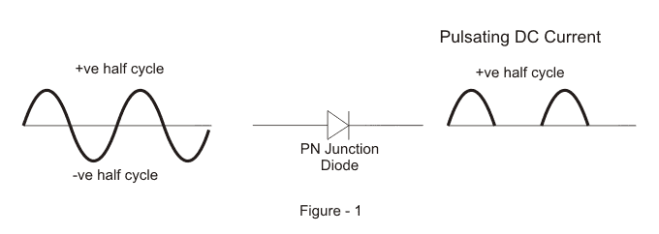
Half Wave Rectifier Theory
A half wave rectifier is the simplest form of rectifier available.
The diagram below illustrates the basic principle of a half-wave rectifier.
When a standard AC waveform is passed through a half-wave rectifier, only half of the AC waveform remains.
Half-wave rectifiers only allow one half-cycle (positive or negative half-cycle) of the AC voltage through and will block the other half-cycle on the DC side, as seen below.

Slide 4
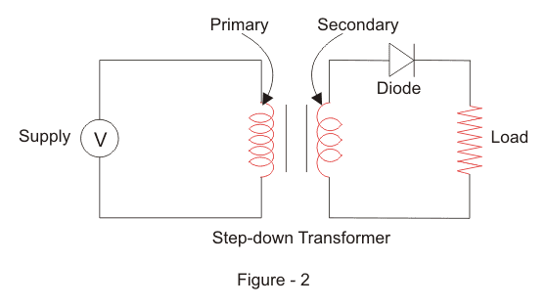
Only one diode is required to construct a half-wave rectifier.
Since DC systems are designed to have current flowing in a single direction putting an AC waveform with positive and negative cycles through a DC device can have destructive (and dangerous) consequences.
So we use half-wave rectifiers to convert the AC input power into DC output power.
But the diode is only part of it – a complete half-wave rectifier circuit consists of 3 main parts:
A transformer
A resistive load
A diode
A half wave rectifier
circuit diagram looks
like this:

Slide 5
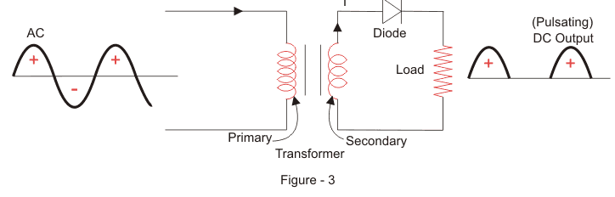
We’ll now go through the process of how a half-wave rectifier converts an AC voltage to a DC output.
First, a high AC voltage is applied to the to the primary side of the step-down transformer and we will get a low voltage at the secondary winding which will be applied to the diode.
During the positive half cycle of the AC voltage, the diode will be forward biased and the current flows through the diode.
During the negative half cycle of the AC voltage, the diode will be reverse biased and the flow of current will be blocked.
The final output voltage waveform on the secondary side (DC) is shown in figure 3 above.

Slide 6
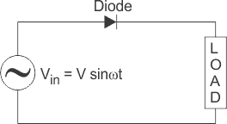
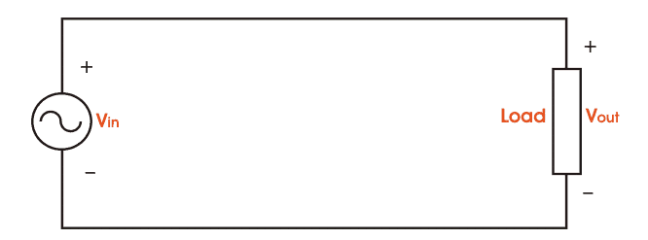
We’ll focus on the secondary side of the circuit. If we replace the secondary transformer coils with a source voltage, we can simplify the circuit diagram of the half-wave rectifier as:
Now we don’t have the transformer part of the circuit distracting us.
For the positive half cycle of the AC source voltage, the equivalent circuit effectively becomes:
This is because the diode is forward biased, and is hence allowing current to pass through. So we have a closed circuit.

Slide 7
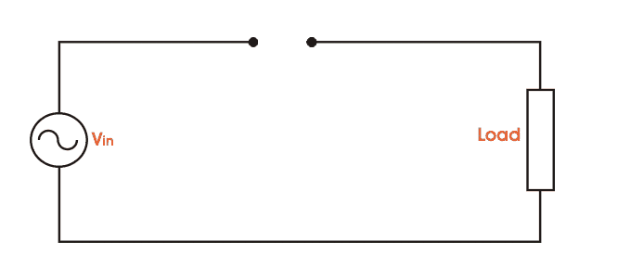
But for the negative half cycle of the AC source voltage, the equivalent circuit becomes:
Because the diode is now in reverse bias mode, no current is able to pass through it. As such, we now have an open circuit.
Since current can not flow through to the load during this time, the output voltage is equal to zero.
This all happens very quickly – since an AC waveform will oscillate between positive and negative many times each second (depending on the frequency).

Slide 8
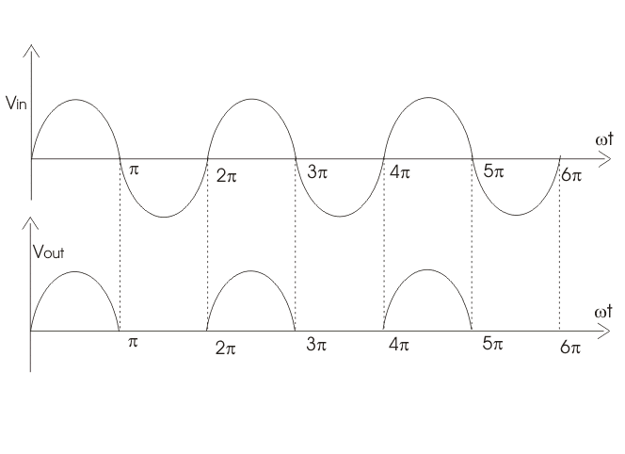
Here’s what the half wave rectifier waveform looks like on the input side (V_{in}), and what it looks like on the output side (V_{out}) after rectification (i.e. conversion from AC to DC):

Slide 9
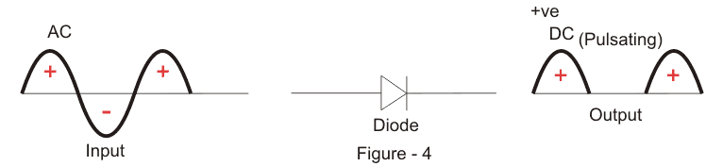
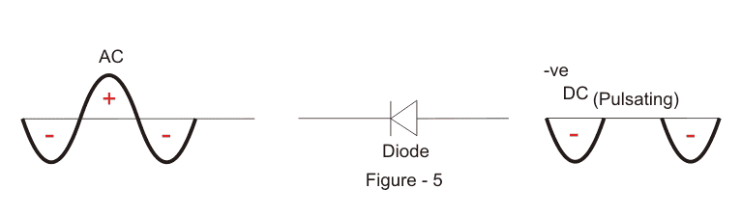
This is a half-wave rectifier which only allows the positive half-cycles through the diode, and blocks the negative half-cycle.
The voltage waveform before and after a positive half wave rectifier is shown in figure 4 below.
Conversely, a negative half-wave rectifier will only allow negative half-cycles through the diode and will block the positive half-cycle.
The only difference between a posive and negative half wave rectifier is the direction of the diode.

Slide 10

Efficiency of Half Wave Rectifier
Rectifier efficiency (η) is the ratio between the output DC power and the input AC power.
The formula for the efficieny is equal to:
The efficiency of a half wave rectifier is equal to 40.6% (i.e. η_{max} = 40.6%)
Output DC Voltage
The output voltage (V_{DC}) across the load resistor is denoted by:

Slide 11
Advantages of Half Wave Rectifier
The main advantage of half-wave rectifiers is in their simplicity. As they don’t require as many components, they are simpler and cheaper to setup and construct.
As such, the main advantages of half-wave rectifiers are:
Simple (lower number of components)
Cheaper up front cost (as their is less equipment. Although there is a higher cost over time due to increased power losses)
Disadvantages of Half Wave Rectifier
The disadvantages of half-wave rectifiers are:
They only allow a half-cycle through per sine wave, and the other half-cycle is wasted. This leads to power loss.
They produces a low output voltage.
The output current we obtain is not purely DC, and it still contains a lot of ripple (i.e. it has a high ripple factor)

Slide 12
Applications of Half Wave Rectifier
Half wave rectifiers are not as commonly used as full-wave rectifiers. Despite this, they still have some uses:
For rectification applications
For signal demodulation applications
For signal peak applications

Slide 13
Full Wave Rectifier
Like the half wave circuit, a full wave rectifier circuit produces an output voltage or current which is purely DC or has some specified DC component.
Full wave rectifiers have some fundamental advantages over their half wave rectifier counterparts.
The average (DC) output voltage is higher than for half wave,
the output of the full wave rectifier has much less ripple than that of the half wave rectifier producing a smoother output waveform.

Slide 14
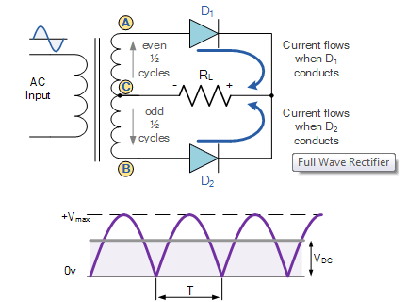
In a Full Wave Rectifier circuit two diodes are now used, one for each half of the cycle.
A multiple winding transformer is used whose secondary winding is split equally into two halves with a common centre tapped connection, (C).
This configuration results in each diode conducting in turn when its anode terminal is positive with respect to the transformer centre point C producing an output during both half-cycles, twice that for the half wave rectifier so it is 100% efficient as shown below.

Slide 15
The full wave rectifier circuit consists of two power diodes connected to a single load resistance (R_{L}) with each diode taking it in turn to supply current to the load.
When point A of the transformer is positive with respect to point C, diode D₁ conducts in the forward direction as indicated by the arrows.
When point B is positive (in the negative half of the cycle) with respect to point C, diode D₂ conducts in the forward direction and the current flowing through resistor R is in the same direction for both half-cycles.
As the output voltage across the resistor R is the phasor sum of the two waveforms combined, this type of full wave rectifier circuit is also known as a “bi-phase” circuit.

Slide 16
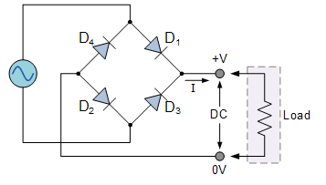
The Full Wave Bridge Rectifier
Another type of circuit that produces the same output waveform as the full wave rectifier circuit above, is that of the Full Wave Bridge Rectifier. This type of single phase rectifier uses four individual rectifying diodes connected in a closed loop “bridge” configuration to produce the desired output.
The main advantage of this bridge circuit is that it does not require a special centre tapped transformer, thereby reducing its size and cost.
The single secondary winding is connected to one side of the diode bridge network and the load to the other side as shown below.

Slide 17
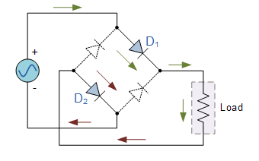
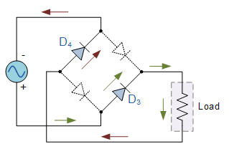
The four diodes labelled D₁ to D₄ are arranged in “series pairs” with only two diodes conducting current during each half cycle.
During the positive half cycle of the supply, diodes D1 and D2 conduct in series while diodes D3 and D4 are reverse biased and the current flows through the load as shown below.
During the negative half cycle of the supply, diodes D3 and D4 conduct in series, but diodes D1 and D2 switch “OFF” as they are now reverse biased. The current flowing through the load is the same direction as before.

